Slide 1

REAL TIME WATER HEAD MONITORING SYSTEM FOR HOUSEHOLDS & APARTMENTS
Under The Supervision of
MR. K.Ravi Kumar M.Tech,(Ph.D)
Assistant Professor
Presented By
Allada Harinisri-21bq1a4701
Department of CSE(IOT,CS inc. BCT)
Vasireddy Venkatadri Institute of Technology
Pedakakani Mandal, Namburu, Gunturu-522508

Slide 2
Contents Outline
Abstract
Introduction
Proposed System with Architecture
Objectives of Proposed System
System Requirements
Hardware Configuration (Computer Resource)
Software Configuration (Technology Stack)
Design
Use case diagram
Sequence diagram
Execution screenshots

Slide 3
Abstract:
The growing concern for efficient water management has prompted the development of innovative solutions to monitor and conserve water resources.
This abstract outlines the concept of a Real-Time Water Head Monitoring System designed specifically for households and apartments.
The Real-Time Water Head Monitoring System integrates advanced sensor technologies, data analytics, and user-friendly interfaces to provide a comprehensive solution for tracking water consumption and detecting potential leaks in residential settings.
By employing a network of strategically placed sensors, the system captures real-time data on water flow rates, usage patterns, and anomalies.
This data is then transmitted to a central hub, where it is processed and analyzed using machine learning algorithms.

Slide 4
Residents are granted access to the system through a user-friendly interface, which offers insights into their water usage patterns, historical data, and personalized conservation tips.
In cases of abnormal water flow indicative of leaks or wastage, the system promptly alerts users through notifications, allowing for timely intervention and prevention of water-related damages.
By detecting and addressing leaks in a timely manner, significant reductions in water wastage can be achieved, leading to environmental benefits and potential cost savings for users.
The Real-Time Water Head Monitoring System presents an innovative approach to water management in households and apartments.
Through its integration of cutting-edge sensor technology, data analytics, and user engagement, the system offers a valuable tool for promoting water conservation and sustainable living practices at the individual and community levels.

Slide 5
Introduction:
Efficiency in water management aims to increase the effective usage of water especially in households.
This can be achieved by reducing the misuse and wastage of the water in households.
Mostly, in households and apartments the major reason for misuse or wastage of the water is due to the water pipe line leakage or overflow of the water tank while filling it.

Slide 6
Proposed System with Architecture:

Slide 7
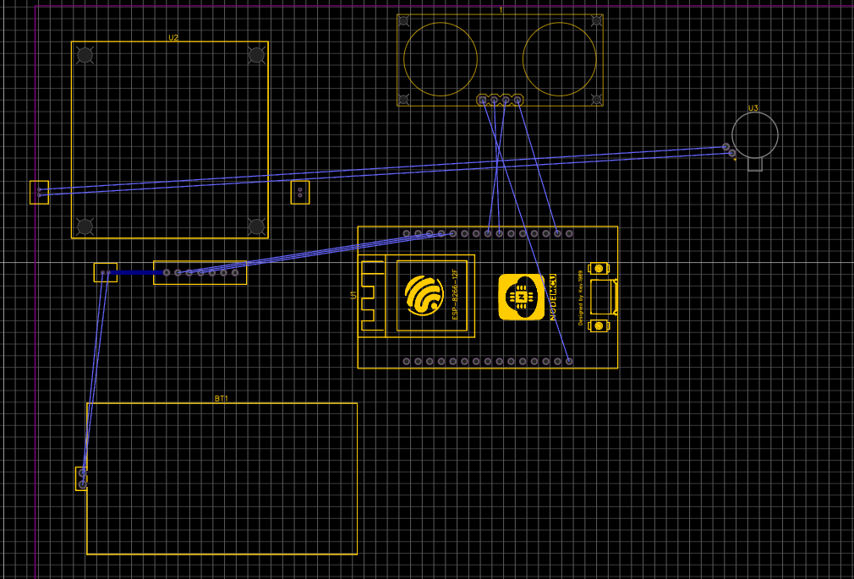

Slide 8
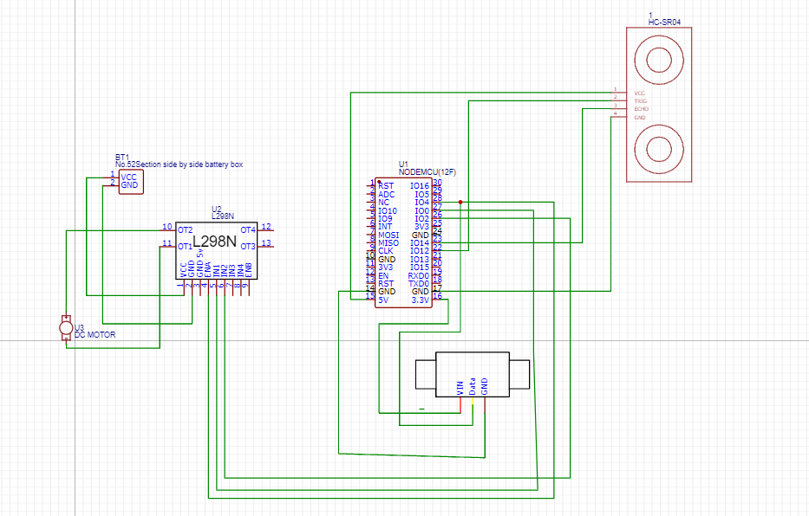

Slide 9
Objectives of the proposed system:
Measure Water Flow:
Use a turbine flow sensor (YF-S201) to measure the flow rate of water in liters per minute.
Calculate the total volume of water that has passed through the system over time.
Monitor Water Level:
Use an ultrasonic sensor (HC-SR04) to measure the water level in a tank.
Determine when the water level is too low (indicating the tank is almost empty).
Control a Motor:
Automatically turn on or off a motor (e.g., a water pump) based on the water level in the tank.
Turn off the motor when the water level is too low to prevent the pump from running dry.
Real-Time Monitoring:
Provides continuous monitoring of water usage and tank levels, which can be crucial for various applications such as agriculture, water resource management, and household water usage.

Slide 10
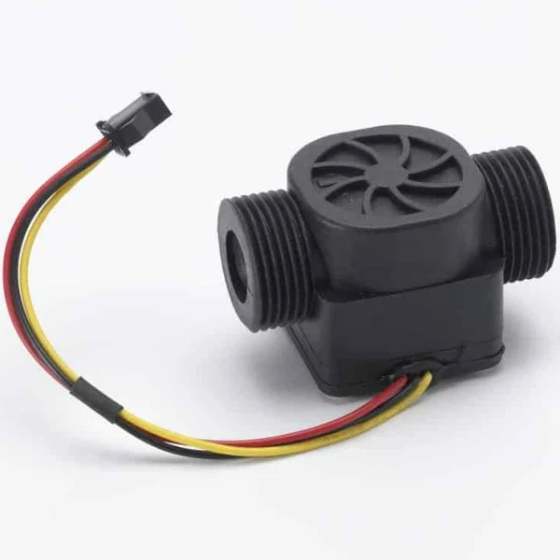
TURBINE FLOW SENSOR
A turbine flow sensor is a sensor that measures the flow rate of a fluid using a turbine.
Turbine flow meters have a free-rotating turbine that spins on its axis as a flowing liquid or gas passes around it.
The turbine flow sensor works on Bernoulli’s principle.
Bernoulli's principle says that as the speed of a fluid increases, its pressure decreases.

Slide 11
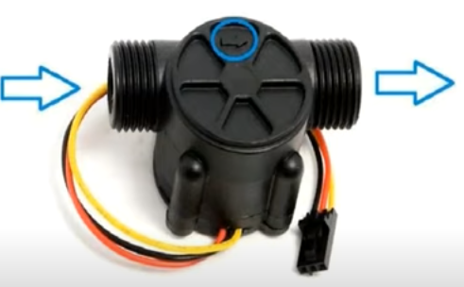
Terminals/Pins:
VCC.
GND.
SIGNAL/OUTPUT.
Connecting sensor with NodeMCU:
Connect the VCC pin of the water flow sensor to the 3.3V output pin on the NodeMCU.
Connect the GND pin of the water flow sensor to the GND pin on the NodeMCU.
Connect the signal/output pin (OUT) of the water flow sensor to any digital input pin on the NodeMCU, for example, D2.
Note: Some water flow sensors might require a pull-up resistor. If needed, connect a 4.7kΩ pull-up resistor between the signal pin (OUT) and the 3.3V pin on the NodeMCU.

Slide 12
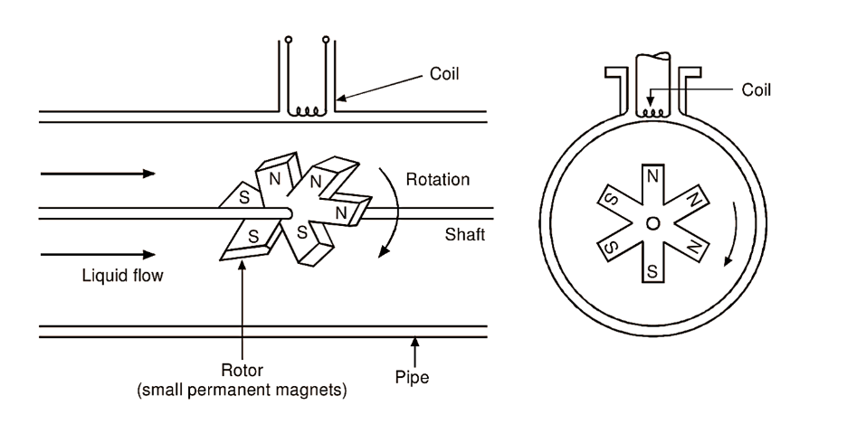
A turbine flow sensor uses the rotational movement of a turbine placed in a fluid stream to generate electrical signals that are then used to measure the flow rate of the fluid passing through the sensor.

Slide 13
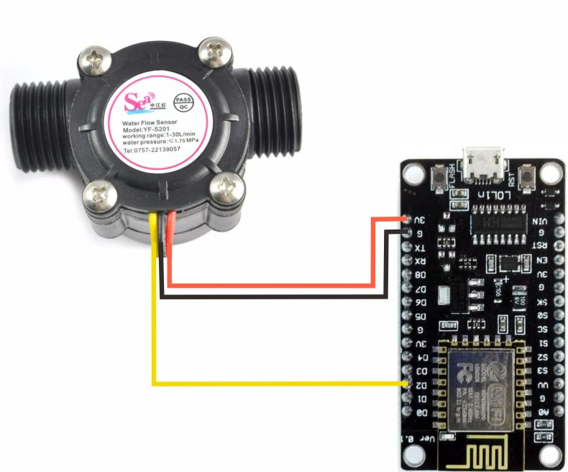
Interfacing Turbine Flow Sensor with the microprocessor(NodeMCU):

Slide 14
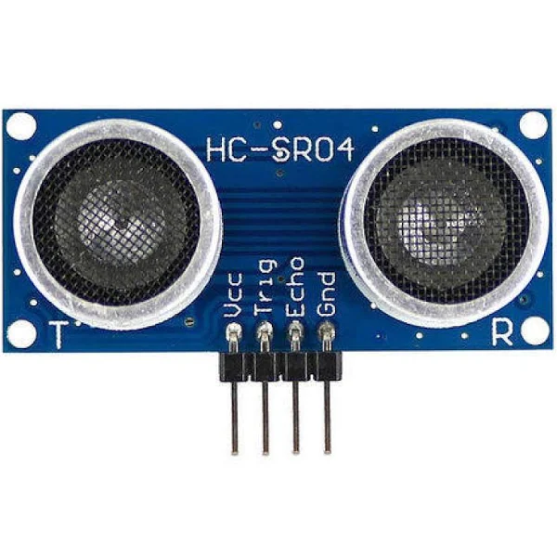
Ultrasonic Sensor
An ultrasonic sensor is an instrument that measures the distance to an object using ultrasonic sound waves.
An ultrasonic sensor uses a transducer to send and receive ultrasonic pulses that relay back information about an object’s proximity.
High-frequency sound waves reflect across boundaries to produce distinct echo patterns.

Slide 15
The working principle of this module is simple. It sends an ultrasonic pulse out at 40 kHz, which travels through the air, and if there is an obstacle or object, it will bounce back to the sensor. By calculating the travel time and the speed of sound, the distance can be calculated.

Slide 16
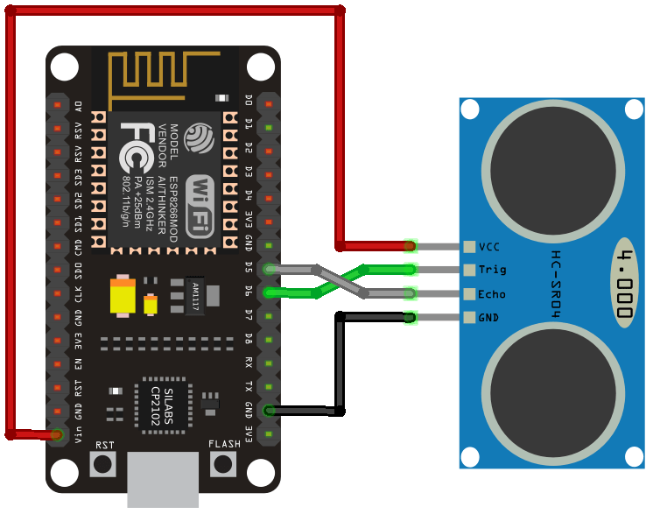
Interfacing Ultrasonic Sensor With NodeMCU:

Slide 17
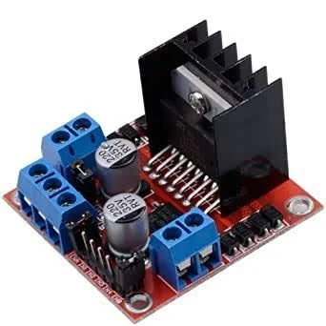
L298N Driver Module:
The L298N is a dual H-Bridge motor driver which allows speed and direction control of two DC motors at the same time. The module can drive DC motors that have voltages between 5 and 35V, with a peak current up to 2A.

Slide 18
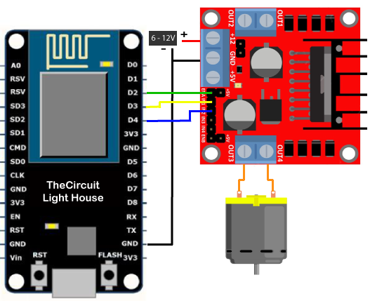

Slide 19
SYSTEM REQUIREMENTS Hardware requirements:
ESP8266(NODEMCU).
Ultrasonic Sensor.
Turbine flow sensor.
L298N Driver Module.
Wifi(3G/4G/5G).

Slide 20
Software requirements:
1.Arduino IDE
2. Data Storage and Database Management
3.ThingspeakIOT.

Slide 21
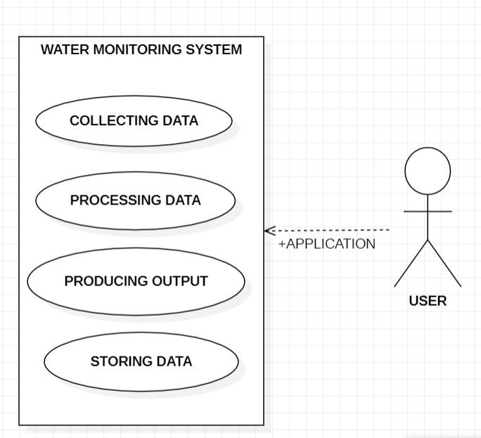
Use case diagram

Slide 22
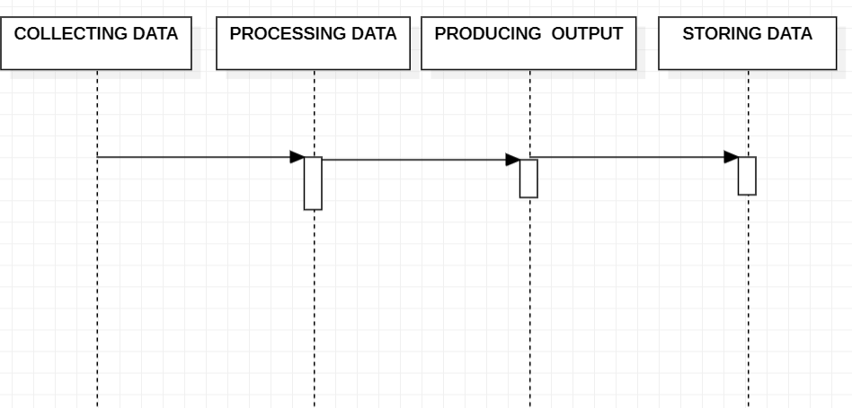
Sequence diagram

Slide 23
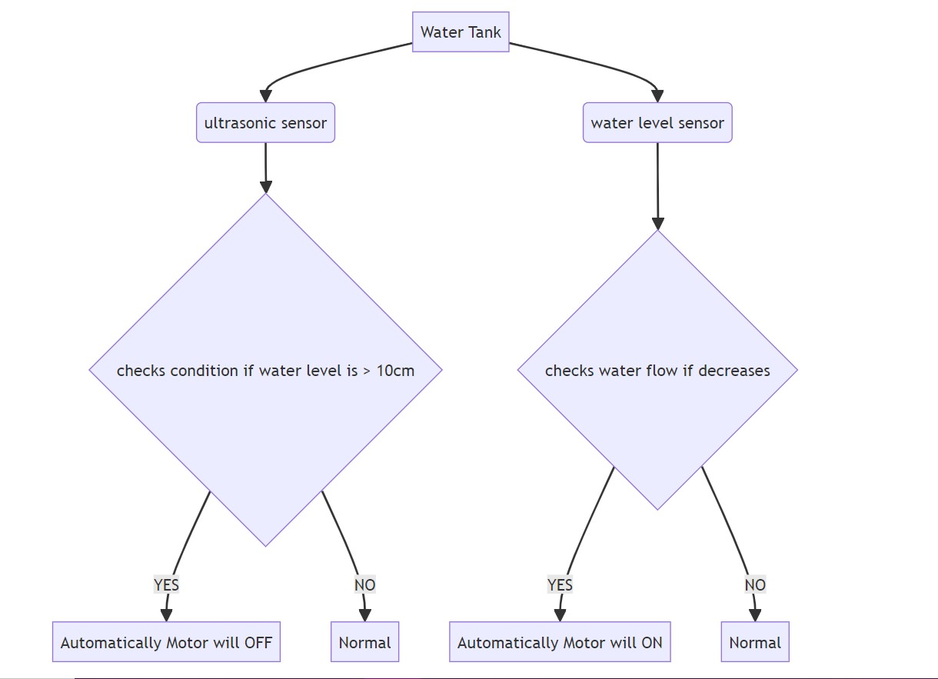

Slide 24
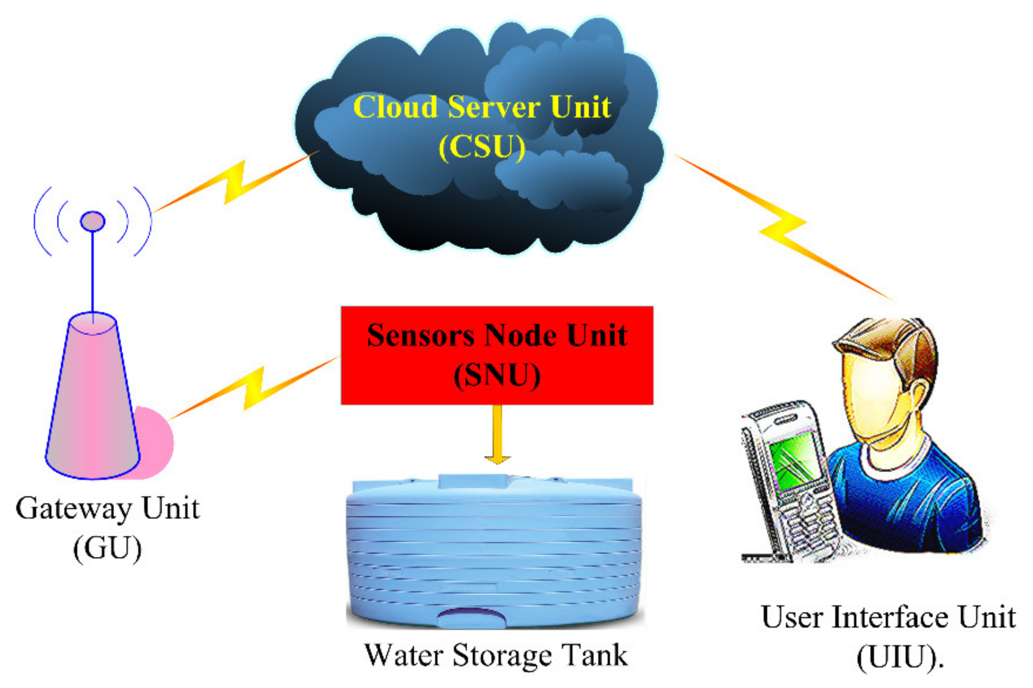
User Interface and Management

Slide 25
Briefly, the SNU captures sensors data (e.g., water level and leakage)
reconditions and processes it, local displays are updated accordingly and then sent to CSU through a Hotspot (local Wi-Fi), ethernet channel, or GSM/GPRS modem.
The GU is responsible for the communication between SNU and CSU.
Almost all internet service providers currently facilitate their customers through the hired cloud servers and other facilities whenever needed.
Today, third parties offer cloud servers for many IoT applications using Blynk app, and thingspeak servers are used.

Slide 26
Execution Screenshots:-

Slide 27
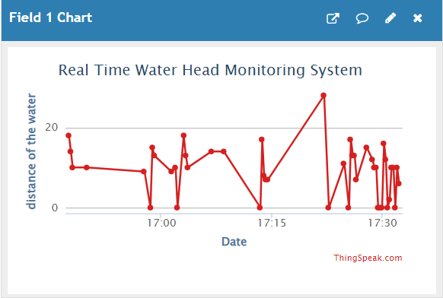
Level Of The Water:

Slide 28
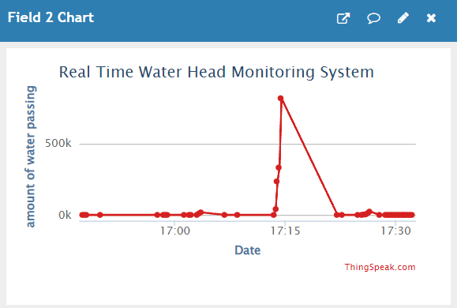
Amount Of The Water Flowing:

Slide 29
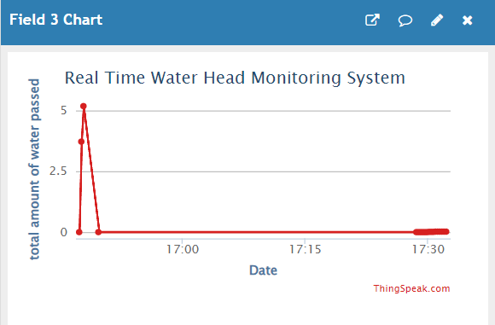
Total Amount Of The Water Used:

Slide 30
Costs of every sensor:
Microcontroller(NodeMCU/Raspberry Pi): ₹164 - ₹8100
Flow Sensor: ₹410 - ₹2000
Ultrasonic Sensor: ₹82 - ₹500
Motor: ₹820 - ₹4100
Miscellaneous: ₹82 - ₹246
---------------------------------
Total: ₹1558 - ₹15000(Approx.)

Slide 31
Future Enhancement (Measuring PH Level ).
By using a PH meter we can find the quality of the water.
If the quality of water is low then the IOT system will send the alert/warning to the end user.
This enhancement ensures safer consumption of the water for the end user.

Slide 32
Thank You…!

